Slide 1




Xamarin training
for mobile app development professionals
Oh, Hello!

Slide 2
Agenda
Introductions and logistics
Agenda for the training
Icebreaker coding exercise

Slide 3
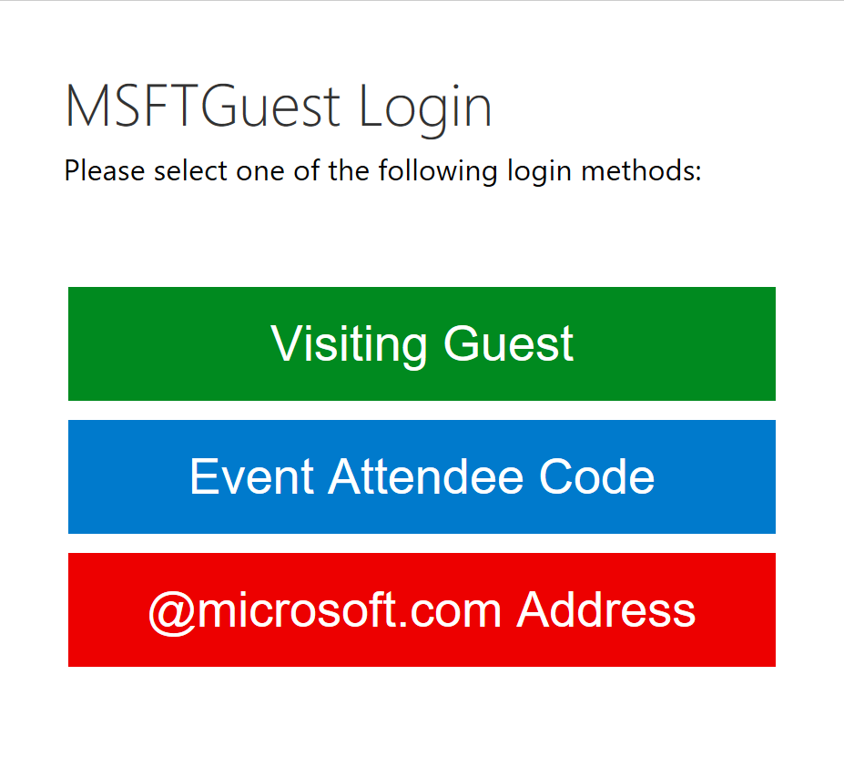
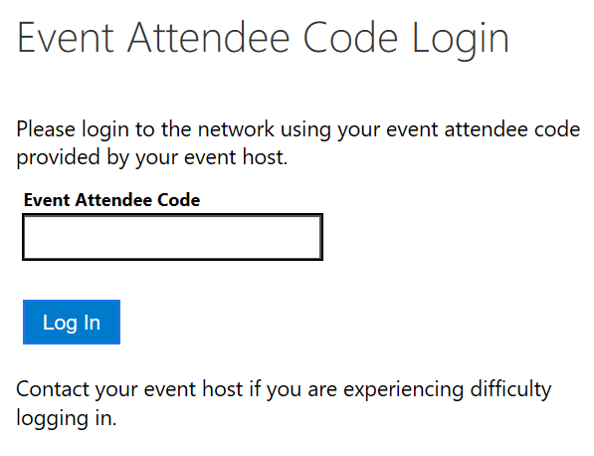
Set up Wi-Fi using an event code
From the list of Wi-Fi options, choose MSFTGuest.
Click the Event Attendee Code button.
In the Event Attendee Code text box, type <code> and then click Log In.

Slide 4
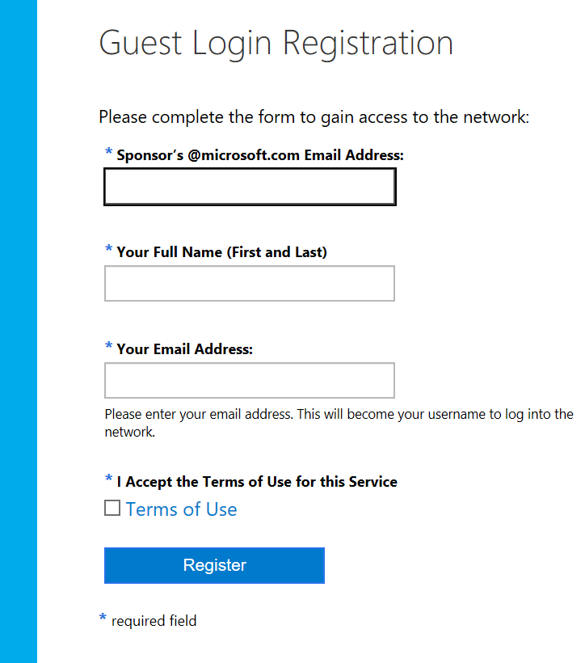
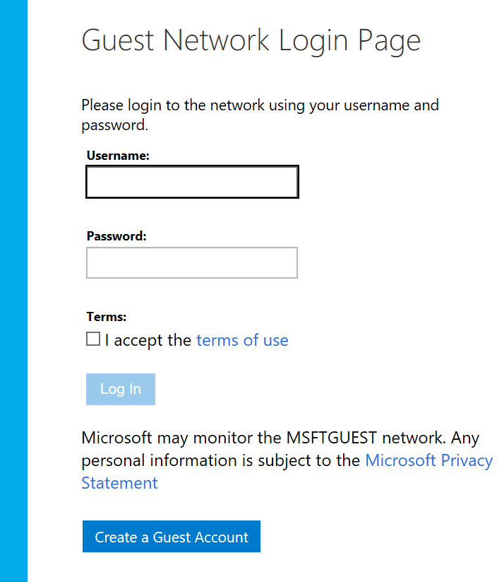
Set up Wi-Fi as a visiting guest
From the list of Wi-Fi options, choose MSFTGuest.
Click the Visiting Guest button.
Click the Create a Guest Account button
Use the MS email address provided to register and then await confirmation

Slide 5



Introducing the Mobile Customer Advisory Team
The team includes mobile architects and developers who are experts in mobile app development in general and Xamarin in particular.
Alex Blount
Dean Faizal
Alexey Strakh

Slide 6




pics
Dean Faizal
Ben Buttigieg
Alex Blount
Mike Parker
Sweeky Satpathy

Slide 7
Logistics and introductions
Logistics
Hours
Feedback
Subject-specific surveys
End-of-course survey
Introductions
Name
Background
Xamarin and mobility experience
Notes:
Hours
We’ll hold class from 9AM – 5PM Monday through Thursday.
Ground rules
Please plan to attend every session as the content and exercises we’ve developed often build on the content presented earlier.
Introductions
Introduce yourself, offer a bit of information about your consulting background and experience with mobile app development in general and Xamarin in particular.

Slide 8
Agenda for the training
FUNdamentals
Development and Architecture
Write Once, Run Everywhere*
Xamarin.Forms

Slide 9
Goals and engagement
Goals of the Xamarin training:
To increase Xamarin proficiency within Services
To develop direct relationships between the Mobile Customer Advisory team and Services consultants so that we can provide support when problems arise.
To develop a mutually beneficial relationship that leads to an increase in wins across the board.
WW Cross-Platform community
This group focuses on topics related to cross-platform technologies (Xamarin, Cordova, etc.) by sharing relevant information and supporting the domain delivery strategy. You can use this community to engage with other consultants in the Modern Apps domain.
Mobile CAT + Services partnership
The Mobile Customer Advisory team and Services are already working together on many presales pursuits. If you need help, please reach out to us via the community or to Derek or Lenny directly. (dedren@microsoft.com and lfenster@microsoft.com)

Slide 10
Resources
Stack Overflow
Use Stack Overflow for questions about error messages, API usage, and other implementation questions. http://stackoverflow.com/
Questions tagged with Xamarin: http://stackoverflow.com/questions/tagged/xamarin
Ask a new Xamarin question: http://stackoverflow.com/questions/ask?tags=xamarin
Xamarin Forums
Use Xamarin Forums for questions on the platform, roadmap, and other general concerns and conversations. https://forums.xamarin.com/
GitHub Issues
Use GitHub Issues to submit bug and issue reports for Xamarin products.
Bugzilla.xamarin.com
Use Bugzilla to search a read-only database of historical bug and issue reports for Xamarin products.

Slide 11
Complete setup (as necessary)

Slide 12
Confirm your setup
Set up MacBook or Mac Mini (or connect to MacStadium)
Install Visual Studio for Mac and Xcode
For details about setting up your Windows machine, see https://university.xamarin.com/resources/win-setup
Complete a custom installation of Visual Studio 2017
Xamarin
Android emulator
Download and install the NUnit Test Adapter 2.0
Within Visual Studio, click Tools, and then click Extensions and Updates.
In the Extensions and Updates dialog box, expand Online, search the Visual Studio Gallery for NUnit, and then click and download NUnit Test Adapter 2.0.

Slide 13
Confirm your setup, continued
Pair Windows with a Mac host for iOS development
Set up Mac to use as a build host
Set up Visual Studio to use your Mac as a build host
Other things:
iOS simulator on Mac
Plug in iOS device to Mac
Visual Studio Emulator for Android
Plug in Android device to Windows PC
Update Android SDKs
Troubleshoot Android installation (as needed)
Troubleshoot running the Android Emulator on newer Windows machines

Slide 14
Icebreaker

Slide 15
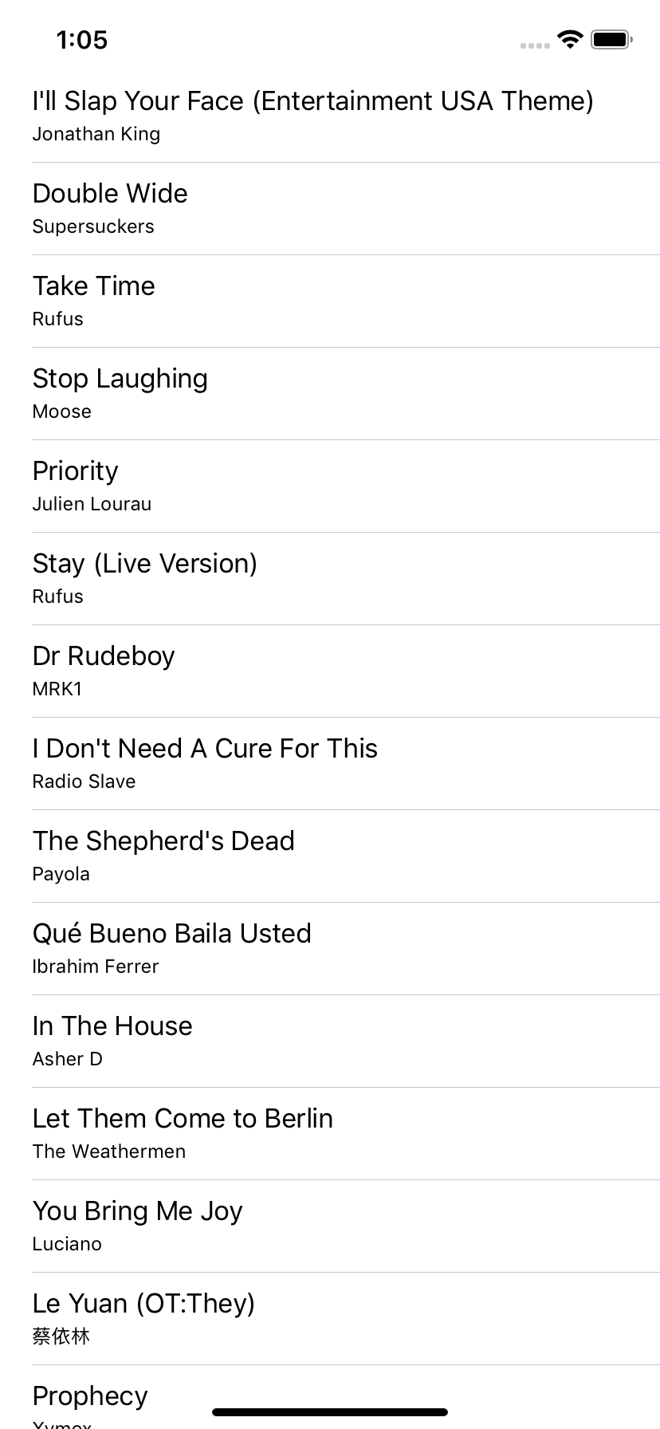
Coding exercise
Download data from the following url and display it in a list:
https://dl.dropboxusercontent.com/s/cv75h76pv9su7l4/songs-small.json
Notes:
The idea is get an understanding of how well you know the underlying platforms, and how fast you find answers to problems/issues you might not know how to address.
http://ullibility.net/wp-content/uploads/2014/09/xamagon-e1423564314550-300x270.png

